Slide 1
Introduction

Slide 2
I. The Role of International Organizations in World Affairs II. What This Course Will Cover III. Why and How to Study This Course

Slide 3


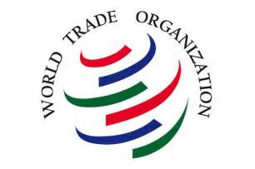
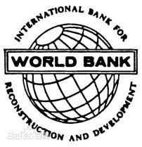
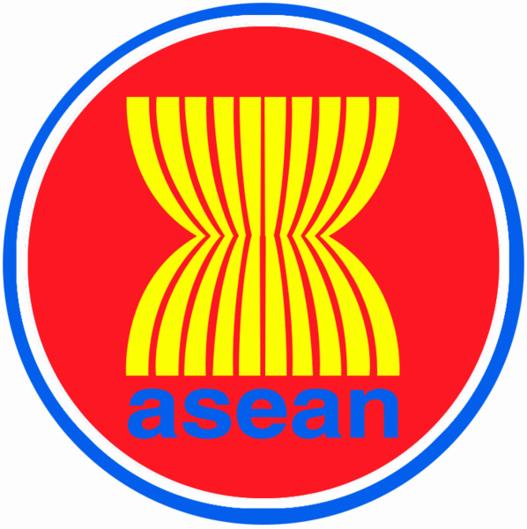

I. The Role of International Organizations in International Affairs
International organizations are non-profit entities established by two or more states or other actors through a formal agreement to pursue shared objectives; their primary purpose is to achieve common goals through cooperation among members.

Slide 4
(I) The Evolution of International Organizations
- International organizations are the product of international relations reaching a certain stage of development.
- Early 19th century: The growth of capitalism gave rise to the earliest forms of international organizations.
- Mid-19th century: The Communist League and the First International emerged as joint bodies of the international proletariat.
- After the 20th century: Expansion proceeded from specialized and technical bodies toward general and political organizations.
- Post-WWI: The first global international organization—the League of Nations—was created.
- On the eve of WWII: The number of international organizations had grown to over 500.
- End of WWII: The second global international organization—the United Nations—was established.

Slide 5
(I) The Evolution of International Organizations
75750
1998年比1990年
增长了81%
48350
81年间
增加了124倍
26656
*数据来源于国际组织联合会官方网站
1117
213
遍布200多个国家；每年仍以1 200个的速度增加

Slide 6
(II) The Role of International Organizations
International organizations influence the functioning of international relations and perform functions that sovereign states cannot replace.
1. Guardians and promoters of international peace and security
They have played a major role in preserving international peace and advancing disarmament. In regional conflicts and international disputes, international organizations often intervene at the right moment as a “third party,” mediating through political and legal channels to ease or end armed conflict.
The special responsibilities borne by the United Nations and its Security Council, and their primacy in maintaining international peace and security, are irreplaceable by any other body.
Regional international organizations also safeguard peace and stability by fostering cooperation among states in their areas, jointly addressing and defusing regional conflicts and disputes.

Slide 7
(II) The Role of International Organizations
2. Pioneers and drivers of global economic and social development （1）Economic dimension
Centered on the IMF, the World Bank, and the WTO, the system of global economic organizations sets rules, upholds order, balances interests, and mediates disputes in the world economy.
（2） Social dimension
The UN Charter places the promotion of development on an equal footing with the maintenance of peace, giving development priority within the Organization’s system and activities.
- This spans economic growth, poverty eradication, social protection, universal education, human rights protection, environmental improvement, disease prevention, and many other areas.

Slide 8
（II）The Role of International Organizations
3. Drafters and overseers of international law
International organizations exert enormous influence on the creation, enrichment, and development of international law; their own evolution is itself a form of legal progress and one of the principal engines driving it.
They function de facto as the architects of international legal principles, rules, and institutions, while also monitoring implementation to ensure that international law is observed and enforced.
To fulfill their mandates and advance their purposes, certain organizations—especially the United Nations—regularly convene international conferences to adopt treaties or establish specialized bodies for the systematic codification of international law.

Slide 9
（II）The Role of International Organizations
4. A stage and arena for multilateral diplomacy, providing a platform for states to engage with one another.
A clear channel for holding meetings, exchanging views, stating positions, raising issues, narrowing differences, defusing conflicts, and deepening understanding.
Since the twenty-first century, multilateral diplomacy—centered on international organizations—has won favor with governments for its flexibility, ease of communication, spirit of cooperation, and high return on low cost.
“The United Nations is a vital source of new ideas and consensus-building. Many proposals that originated here and were once dismissed as too radical have ultimately been embraced by the international community and turned into workable policy options.”
—UN Secretary-General Boutros Boutros-Ghali

Slide 10
（II）The Role of International Organizations
5. De facto managers and coordinators of the international community
The advance of economic globalization, deepening inter-state interdependence, and the emergence of global issues have created both the necessity and the opportunity for international organizations to act.
Thanks to their inherent characteristics, the rules and procedures they craft for addressing problems are readily accepted by all parties and help lower the cost of interstate negotiations.
International organizations can leverage their institutional networks to participate in, guide, manage, and coordinate the activities of various actors across different fields.

Slide 11
II. Course Content
Chapters 1–4: Fundamentals of international organizations.
These chapters survey the overall landscape—concept and characteristics, membership features, relevant theories, historical evolution, and institutional operation.
Chapters 5–8: Functions and roles of international organizations.
They examine the principal contributions IOs make today in political & security affairs, economic cooperation, law, and global governance.
Chapter 9: International Non-Governmental Organization
This chapter analyzes the concept, traits, types, evolution, and growing impact of INGOs in international cooperation.
Chapter 10: China and international organizations.
A systematic review of the historical development, current state, and future trends of China’s engagement with IOs.

Slide 12
III. Why Study This Course
1. Understand the development history, characteristics, operational mechanisms of international organizations, as well as their status and role in international affairs.
2. Recognize the significance of international organizations to China:
– They serve as the primary stage for China’s multilateral diplomacy, providing a channel for China to manage its relations with other countries and to engage in mutual exchanges and cooperation with nations around the world.
– They are important venues for China to safeguard its national interests.
– They are indispensable platforms for China to fulfill its role as a responsible major country and to contribute to world peace and the cause of development and progress.

Slide 13
IV. Research Methods
1. Guided by Marxism, the course employs the world-view and methodology of dialectical and historical materialism to study international organizations, expounding and uncovering the general laws of their emergence and evolution.
(1) Movement of society’s basic contradictions
By analyzing the interplay between productive forces and relations of production in the process of economic globalization, we reveal the patterns and trends behind contemporary IO development.
(2) Theory of historical resultant forces
History evolves from the clash, compromise, and synthesis of individual wills; likewise, international organizations take shape and grow through cooperation among their members.
(3) Integration with the theory and practice of major-country diplomacy with Chinese characteristics, especially China’s evolving understanding of international organizations.

Slide 14
IV. Research Methods
2. Systems-analysis approach
Treat each international organization as a system and focus on its internal operating mechanisms, thereby uncovering the organization’s distinctive functions and the laws governing its evolution, so as to provide a scientific basis for political decision-making and implementation.
Main techniques include element analysis, structural analysis, and environmental analysis.

Slide 15
IV. Research Methods
3. Comparative method
- Identify similarities and differences among different international organizations or among distinct components within the same organization.
- Combine macro- and micro-level perspectives, weave together longitudinal and cross-sectional dimensions, and give equal weight to dynamic and static viewpoints in order to study both the IOs and the international society in which they operate.
- Reveal the general patterns, particularities, and limitations of their development and change, thereby grasping their essence, characteristics, and evolution and enabling sound evaluation.

Slide 16
IV. Research Methods
4. Interdisciplinary approach
- The study of international organizations is simultaneously a field within international law, a sub-discipline of world history, and a vital component of international political science.
- It imports theories, methods, and findings from sociology, public administration, psychology, economics, management, and other disciplines; through mutual borrowing and cross-fertilization, these fields jointly advance research on international organizations.

